Slide 1
SpendWise
Project Title
SpendWise – A Simple Backend Learning Project using Node.js, Express, MongoDB, and JWT
Project Overview
SpendWise is a backend application designed to help beginner developers learn how to build secure REST APIs using Node.js, Express, MongoDB, and JWT authentication. The project focuses on implementing user authentication and basic CRUD operations in a clean and simple way so students can understand how backend systems work in real-world scenarios.
Key Objectives:
Provide secure user authentication using JWT
Enable basic CRUD operations on user data (transactions/records)
Demonstrate MongoDB integration using Mongoose
Show how protected routes work using middleware
Maintain a simple and beginner-friendly backend architecture
Target Users:
Beginner backend developers
Students learning Node.js and Express
Freshers preparing for technical interviews
Anyone who wants a simple project to understand JWT and MongoDB
Learners who want hands-on practice with REST APIs

Slide 2
Project Instruction
SpendWise is a backend-only project built using Node.js and Express.
Quick Start:
npm init npm install npm run dev
Steps to Create the Project:
Choose or create a directory for the backend project.
Open terminal and navigate to that directory.
Initialize Node.js project using npm init.
Install required packages: express, mongoose, jsonwebtoken, bcrypt, cors, dotenv.
Create folders: models, routes, controllers, middleware, config.
Start the server using npm run dev.
Test APIs using Postman or Thunder Client at http://localhost:5000.
Pre-requisites:
Software Requirements
Software
Purpose
Node.js
JavaScript runtime for backend
MongoDB
NoSQL database for data storage
npm
Package manager
Git
Version control system
Code Editor
VS Code or similar
Knowledge Requirements
JavaScript ES6+

Slide 3
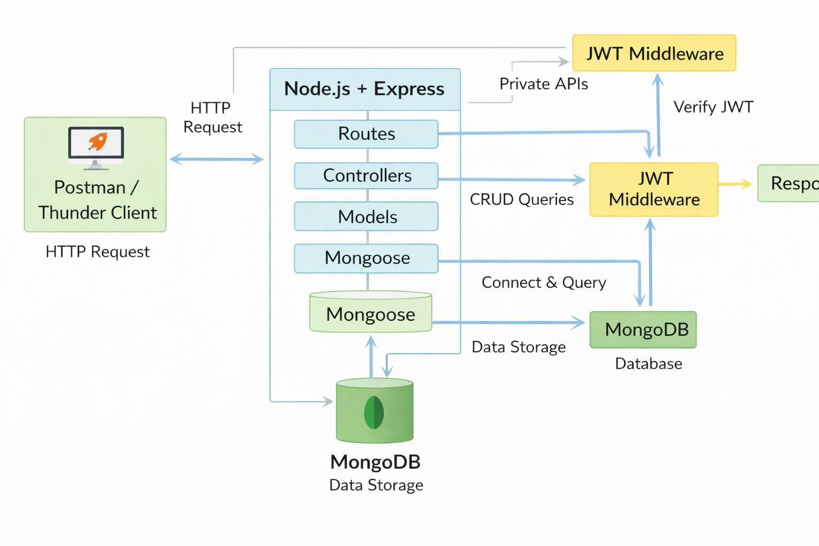
Node.js and Express.js
MongoDB and Mongoose
JWT authentication
Basic REST API concepts
Git basics
Thumbnail for Project
A simple backend project thumbnail representing:
Node.js + Express + MongoDB + JWT + CRUD APIs
Project Architecture Image

Slide 4
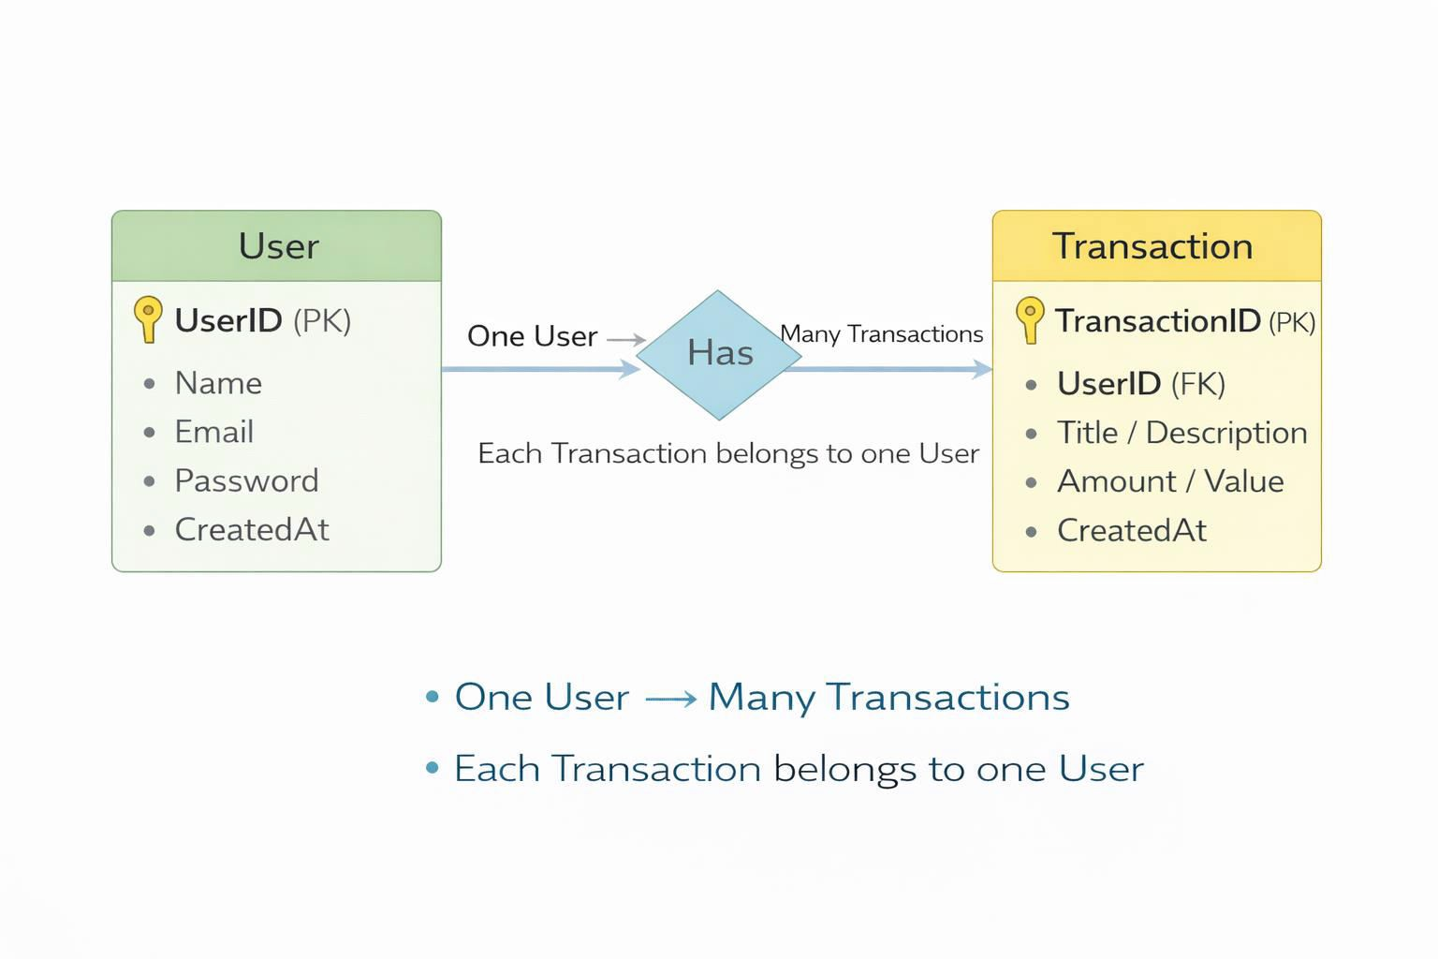
Technical Architecture
Backend Architecture (Node.js + Express)
Controllers: Handle business logic for authentication and CRUD
Models: Mongoose schemas for User and Transaction
Routes: API endpoints for auth and CRUD operations
Middleware: JWT verification and request protection
Configuration: Database connection and environment variables
Database Architecture (MongoDB)
Users Collection:
_id, name, email, password (hashed), createdAt
Transactions Collection:
_id, userId (FK), title/description, amount/value, createdAt
Relationship:
Many Transactions belong to One User
ER Diagram

Slide 5
Features
Feature
Description
User Authentication
JWT-based registration and login
CRUD Operations
Create, Read, Update, Delete transactions
Protected Routes
Secure APIs using JWT middleware
MongoDB Integration
Store and fetch data using Mongoose
Roles and Responsibilities
Student / Developer:
Write backend code
Create APIs
Test APIs using Postman/Thunder Client
Push code to GitHub
System (Backend):
Authenticate users using JWT
Handle CRUD operations
Store and fetch data from MongoDB
Protect private routes

Slide 6
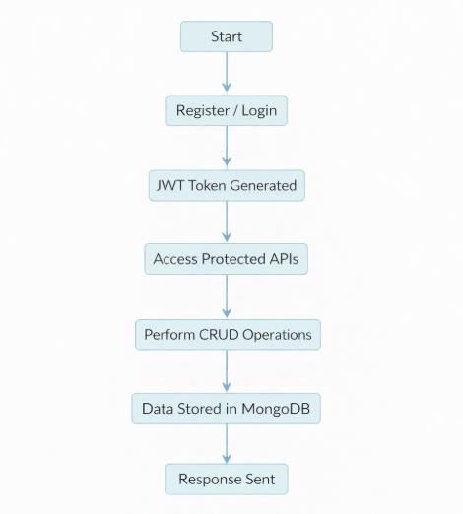
Users Flow:

Slide 7
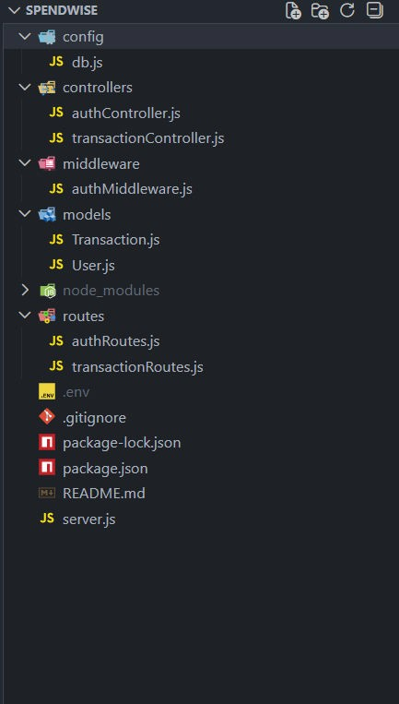
PROJECT SETUP AND CONFIGURATION
Folder Structure
Project Setup
Install required tools:
  Node.js
  MongoDB
Create project folders:
server folders (models, routes, controllers, middleware, config)
Install Backend Packages:
  Express
  Mongoose
  Cors

Slide 8
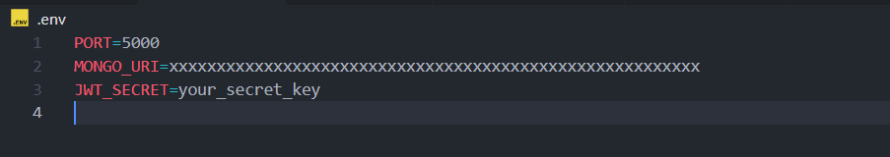
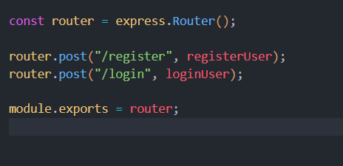
Jsonwebtoken
Bcrypt
Dotenv
BACKEND DEVELOPMENT
Setup Express server
Create server.js file
Create .env file and define PORT and DB URL
Configure middleware (cors, express.json)
User Authentication:
  Create Register and Login routes
  Generate JWT token
  Protect routes using middleware
Define API Routes:
  Auth routes
Transaction CRUD routes
Implement Data Models:
User schema

Slide 9
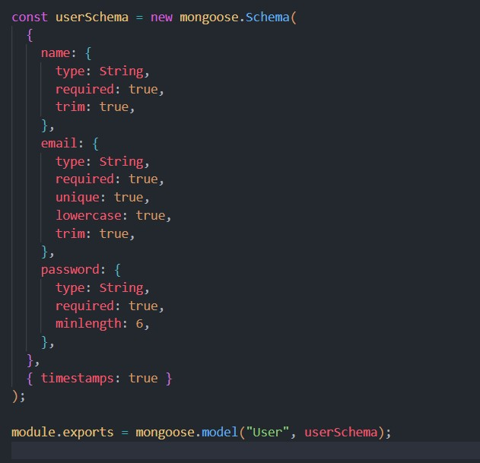
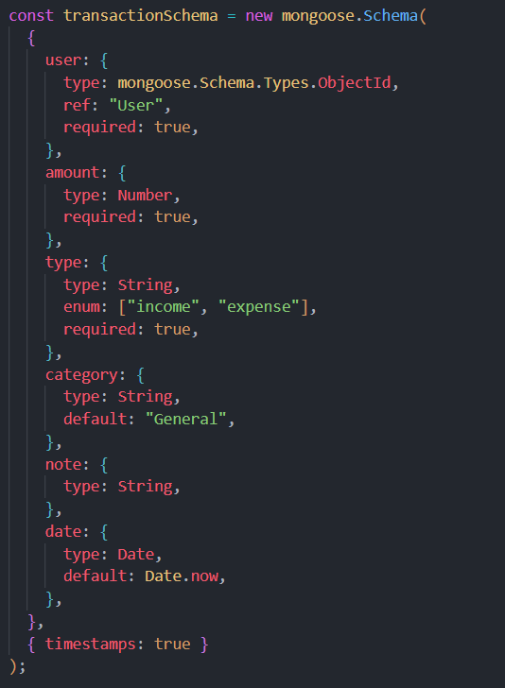
Transaction schema

Slide 10
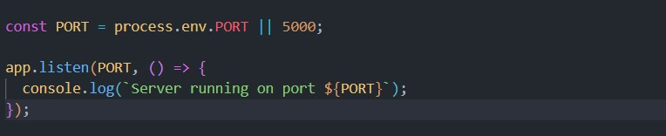
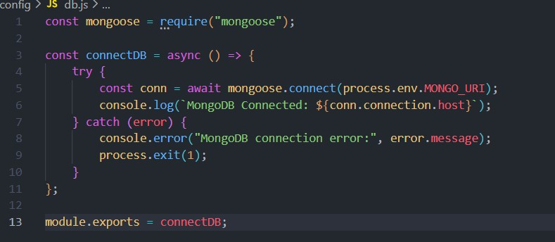
DATABASE DEVELOPMENT
Implement CRUD operations
Add basic error handling
Configure MongoDB
Use MongoDB Atlas or local MongoDB
Store connection URL in .env file
Connect using Mongoose
Create Database Connection
Create a config file for DB connection
Use mongoose.connect()
Handle success and error cases

Slide 11
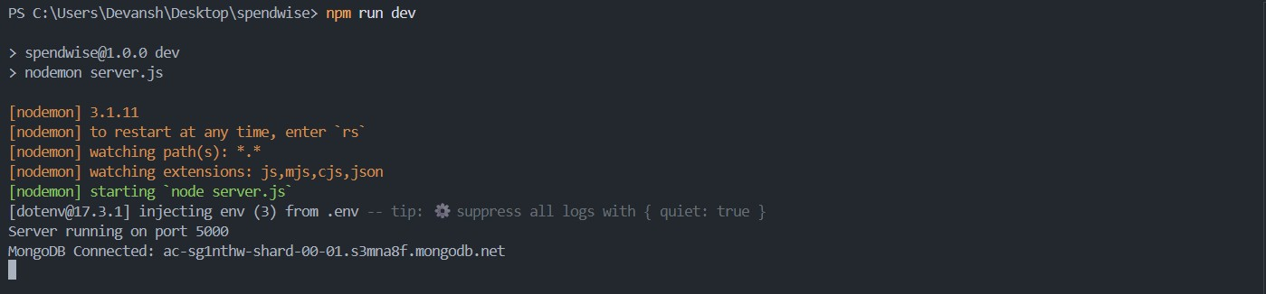
Create Schema and Models
User Model:
Name
email
password
Data / Transaction Model:
userId
title / description
amount / value
timestamps
PROJECT EXECUTION
Project Execution Steps:
Start MongoDB
Run backend server
3. Test Register API

Slide 12
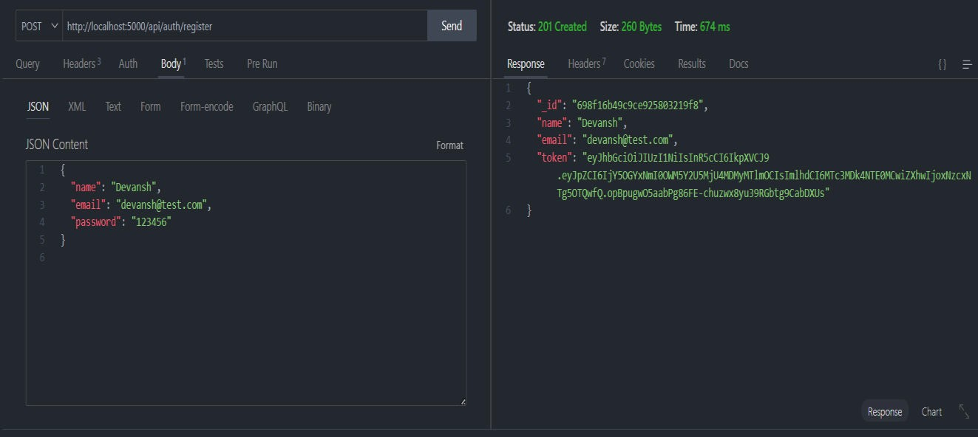
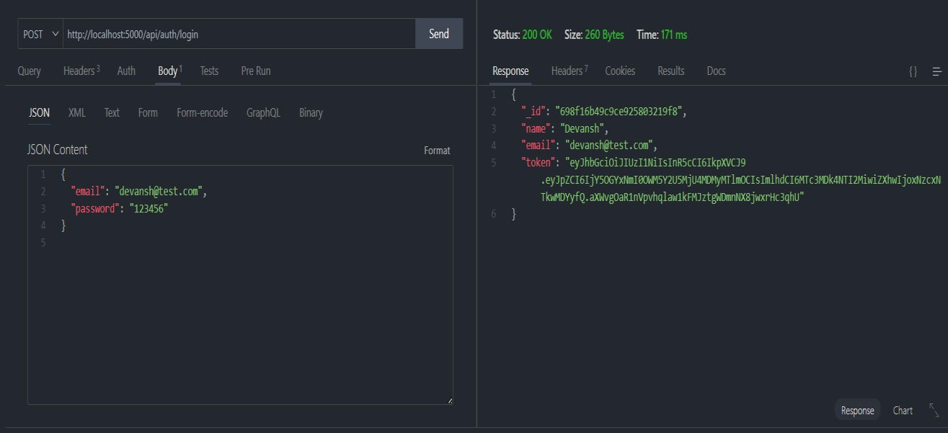
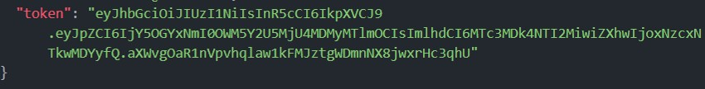
4. Test Login API
5. Copy JWT token
Use token to access protected CRUD APIs
Perform Create, Read, Update, Delete operations
OUTPUT SCREENSHOT
1. Register API

Slide 13
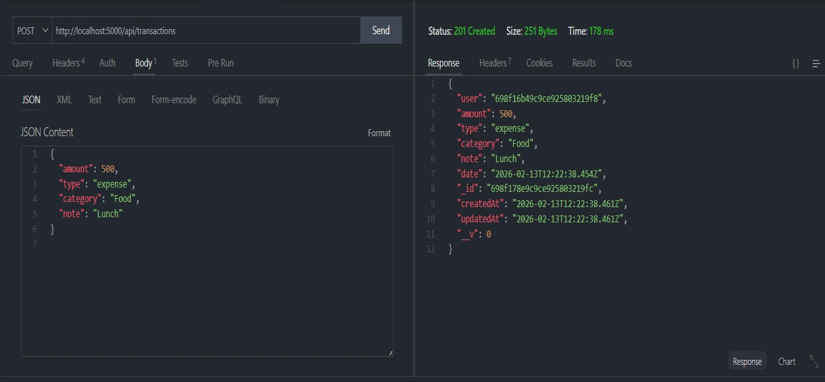
2. Login API
3. Create Transaction
4. Get information

Slide 14
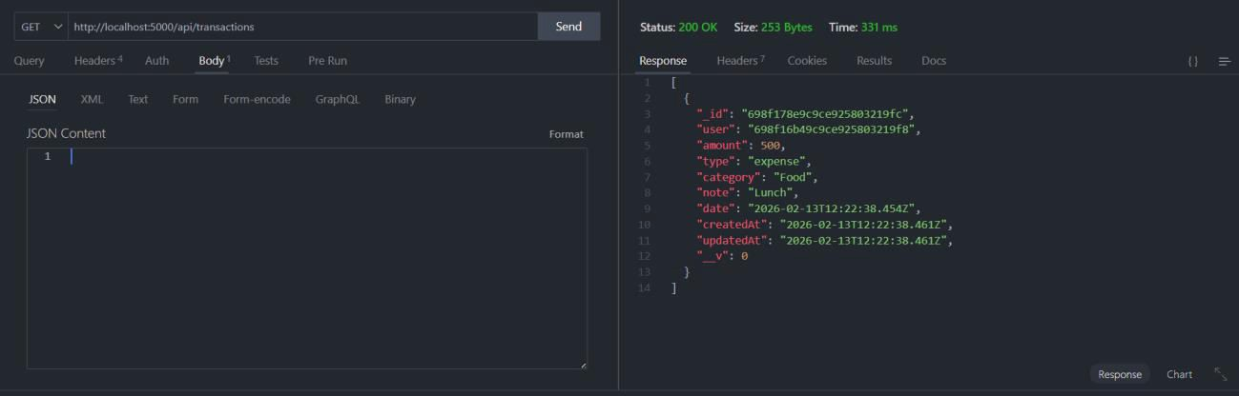
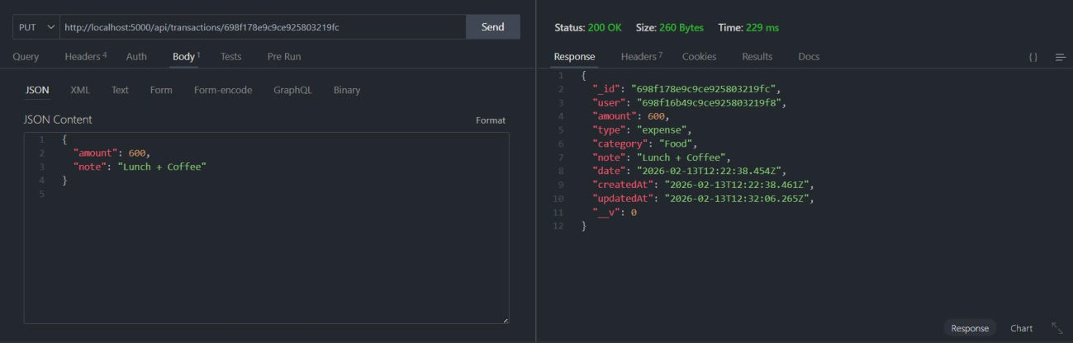
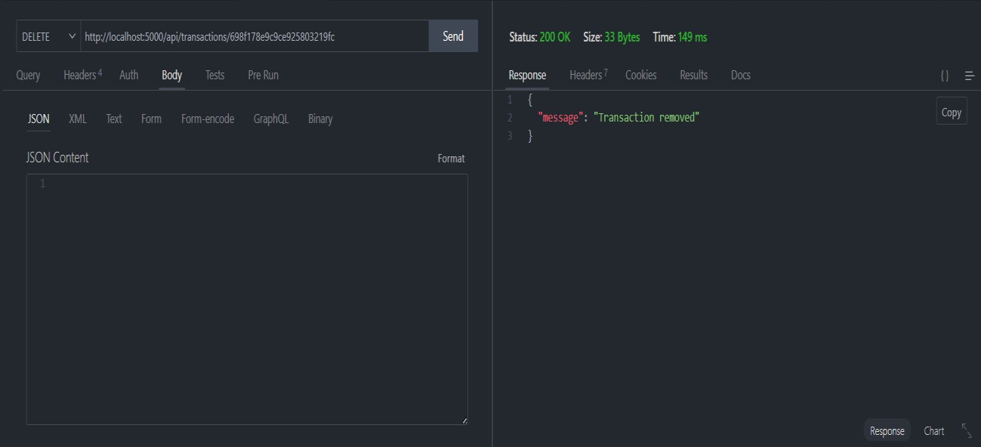
5. Update API
6. Delete API

Slide 15
Project Demo Video
SpendWise (video).mp4
Drive Link : SpendWise

